Slide 1
Masks: Why, When and How
C/Lt. Col Jacquelyn Harsha
SWR Cadet Safety Officer

Slide 2
Overview
-Why should we wear masks?
-When should we wear masks?
-How should we wear masks?
-What makes a good mask?
-How to clean your own masks
*all information taken from CDC guidelines link: https://www.cdc.gov/coronavirus/2019-ncov/prevent-getting-sick/cloth-face-cover.html

Slide 3
Why should we wear masks?
-In light of new data about how COVID-19 spreads, along with evidence of widespread COVID-19 illness in communities across the country, CDC recommends that people wear a cloth face covering to cover their nose and mouth in the community setting.
-This is to protect people around you if you are infected but do not have symptoms.

Slide 4
-When should we wear masks?
-A cloth face covering should be worn whenever people are in a community setting, especially in situations where you may be near people.
-These settings include grocery stores and pharmacies. These face coverings are not a substitute for social distancing.
-Cloth face coverings are especially important to wear in public in areas of widespread COVID-19 illness.

Slide 5
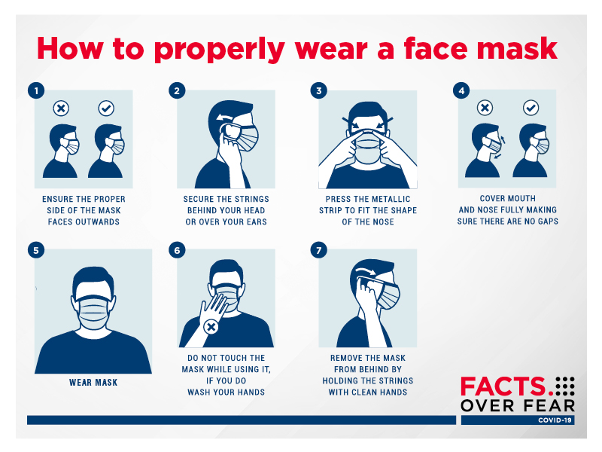
How should we wear masks?

Slide 6
What makes a good mask?
-Masks can be fashioned from household items such as scarves, cloths and even t-shirts. However, recent studies suggest that the higher the thread count, the better the cloth may be as a filter.
-Surgical masks or N-95 masks are not necessary if the recommended 6ft social distancing, and voluntary face coverings are used.
-Masks can also be made out of fabric such as layers of cotton and flannel.

Slide 7
7

Slide 8
How to clean your own masks
(While not on the CDC website, most information is common sense)
-DO NOT: Microwave or bake your masks. This may cause fires.
-DO: Hand wash with soap and water, dry completely before wearing again. Some masks can be machine washed, check label for specific instructions.

Slide 9
Summary
-Why should we wear masks?
-When should we wear masks?
-How should we wear masks?
-What makes a good mask?
-How to clean your own masks
*all information taken from CDC guidelines link: https://www.cdc.gov/coronavirus/2019-ncov/prevent-getting-sick/cloth-face-cover.html
9

