Slide 1
Cell Phone Use While Driving Why it is a crash risk
Notes:
We need much more than “eyes on the road, hands on the wheel” when driving. We also need our minds on driving. Because hands-free is not risk-free.
But a National Safety Council survey found that 80% of American drivers mistakenly believe hands-free devices are safer than using a handheld phone.
Today we’ll talk about the distraction risks of talking on cell phones, including the mental distraction of talking on phones handheld and hands-free, because people are less likely to be aware of that distraction risk.

Slide 2
Impact of Car Crashes
100 people die in crashes every day
About 35,000 deaths each year
#1 cause of injury death across lifespan
#1 cause of death for teen drivers
Notes:
Driving is actually the most dangerous activity that we are regularly involved in.
According to this CDC chart (Centers for Disease Control and Prevention), car crashes are the #1 cause of death due to injury throughout our lives. Car crashes kill more people across all ages than other causes of injury. Although unintentional poisonings are now a leading cause of death from ages 25-64, car crashes are the #2 cause of death during those ages, and across the lifetime car crashes rank #1.
They rank #1 among all causes of death for teens.
These are preventable deaths that didn’t have to happen. This is why it’s important to seriously address all the leading causes of crashes.

Slide 3
Impact of Car Crashes
Notes:
Although we might hear about other causes of death in the workplace more often, driving on the job can be dangerous. Vehicle crashes – trucks, cars, etc. are the #1 cause of workplace death.

Slide 4
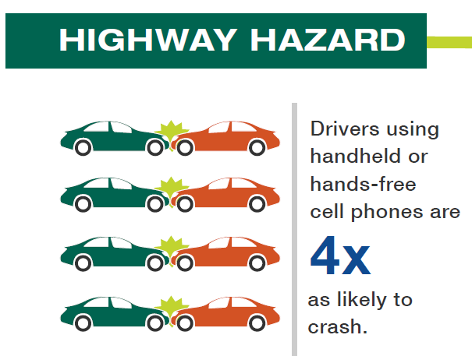
Causes of Car Crashes
Human error is the #1 factor in car crashes
Distraction is a leading factor in car crashes
Cell phones are a top driver distraction
Notes:
People may think that vehicle problems like tire maintenance issues, or the environment like weather and road condition, are factors in most crashes. The fact is, the vast majority of the time, driver error is the cause of crashes. In early 2015, NHTSA released findings that vehicle and environmental factors are the problem only 4% of the time. Driver error is the cause of crashes 96% of the time.
Crashes due to distractions are a common driver error.
Although drivers do many distracting things while driving, cell phones are a leading distraction due to their level of risk and because so many drivers use them for long periods at a time each day.
Studies have shown that drivers using handheld and hands-free cell phones are four times as likely to crash.

Slide 5
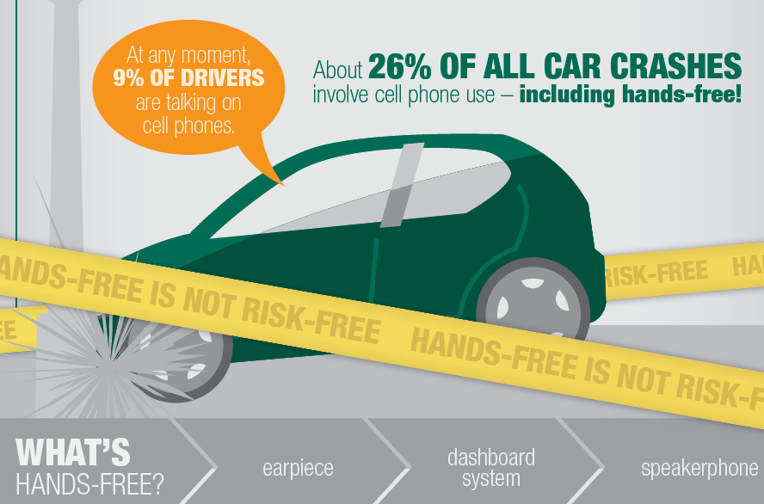
Cell Phones are a Top Distraction
Notes:
The numbers of drivers using phones behind the wheel come from observations that the National Highway Transportation Safety Administration does annually at intersections. The most recent available estimates are from 2013. NHTSA found that 9% of drivers are talking on cell phones at any daylight moment. This is a large number of drivers.
Drivers are aware when they are visually or manually distracted, like when turning to reach for something in the back seat. So drivers tend to limit how often and for how long they do these distractions while driving.
Unfortunately drivers tend to not be aware when they are mentally distracted (also called cognitively distracted), like when talking on a phone, so the distraction lasts longer because the driver does not stop.
This is why we focus so much on preventing cell phone distraction.
The National Safety Council estimates that cell phone use is involved in about 26% of all car crashes.
Are you surprised that cell phones could be involved in so many crashes? The NSC estimate is determined from the crash risk of using cell phones, and the large number of people using phones while driving. The estimate includes all crashes -- property damage crashes like fender benders, more serious property damage crashes, as well as injury and fatal crashes.
The risk of crashing while talking on a cell phone was found in two different studies – one in Australia and one in Canada. Both found the same result. Researchers studied drivers who had been in injury crashes severe enough to go to the emergency room, and drivers who were in property damage crashes.
The risk of crash is four times as likely when using phones while driving – handheld or hands-free

Slide 6
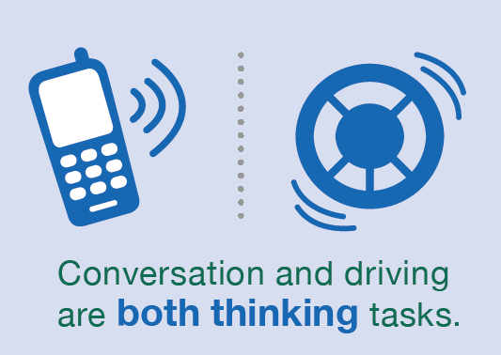
Conversation is Distracting
30 studies found no safety benefit to hands-free devices
This is because of the conversation on phones
Talking on a cell phone is mentally distracting
Trying to do two thinking tasks at one time is mentally distracting
Notes:
NSC compiled the results of more than 30 research studies that looked at drivers using both handheld and hands-free phones. There was no safety benefit to using hands-free devices.
If you would like more information about mental distraction, visit:
Understanding the Distracted Brain white paper: http://www.nsc.org/DistractedDrivingDocuments/Cognitive-Distraction-White-Paper.pdf
Multi-Tasking Lie infographic: http://www.nsc.org/learn/NSC-Initiatives/Pages/distracted-driving-the-great-multitasking-lie-infographic.aspx
Hands-free is not Risk-free infographic: http://www.nsc.org/learn/NSC-Initiatives/Pages/distracted-driving-hands-free-is-not-risk-free-infographic.aspx

Slide 7
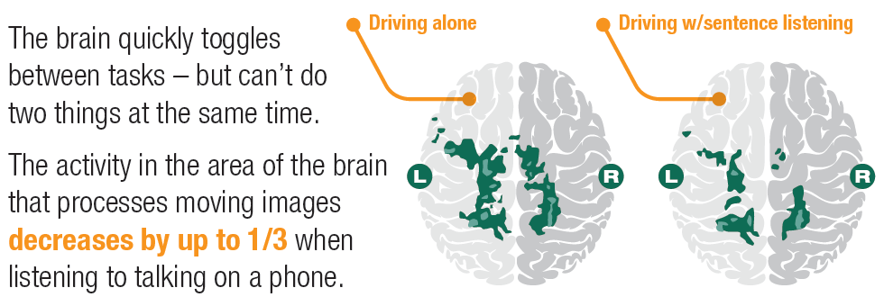
Conversation is Distracting
Notes:
Why is conversation on cell phones distracting while driving? It’s like a bottleneck happening in the brain. Or like when your computer is slower because there’s too many programs or windows open, and too much information to handle.
These show brain images from an MRI study done at Carnegie-Mellon University, where people drove on a simulator while listening to people talking on a phone.
The same area of the brain that handles conversation also processes moving images. So things that can seem unrelated – like talking and seeing the roadway – can need the same area of the brain at the same time. And it’s too much for the brain to handle at once.

Slide 8
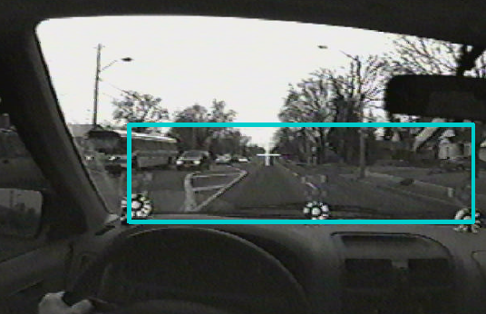
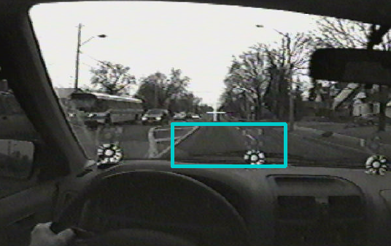
Conversation is Distracting
Off the phone
On the phone
Notes:
These pictures show what happens when drivers talk on a phone. These are from a research study in Canada where drivers were talking on hands-free devices. The blue boxes show where the driver’s eyes looked when they were talking on a phone hands-free, and when they were not.
When drivers talk on cell phones, they may be looking through the windshield, but they aren’t visually scanning for everything they need to see to drive safely.
The blue rectangles show that drivers talking on phones used less peripheral vision and not only that, didn’t even scan visually across the road directly in front of them. They weren’t looking further up the road to watch for upcoming hazards. This would make it harder for them to notice a hazard and take evasive action if needed.
A big part of safe driving is always seeking the unexpected and being prepared to deal with it if it happens.
But drivers talking on phones tended to focus on a small area of the road immediately in front of their vehicles. Hazards that could happen further up the road – a car pulling out of a driveway, a bicyclist or pedestrian crossing – are not in the driver’s view.

Slide 9
Conversation is Distracting
Drivers talking on cell phones, handheld or hands-free, can miss seeing 50% of what’s around them
Notes:
Studies show that drivers talking on cell phones experience what’s called “inattention blindness.”
These drivers:
Did less visual monitoring of dashboard instruments and mirrors. Some drivers entirely abandoned those tasks.
Made fewer glances to traffic lights at intersections. Some drivers did not even look at traffic signals.
Miss visual cues critical to navigation like exit signs and street signs.
Miss both high and low relevant objects, showing a lack of ability to allocate their attention to the most important visual information.
The danger of inattention blindness is that when a driver fails to notice events in the driving environment, either at all or too late, it’s impossible to respond such as a steering maneuver or braking to avoid a crash.
Drivers can miss seeing pedestrians, bicyclists, motorcyclists, red lights, stop lights and stopped traffic even when these things are in front of them.

Slide 10
The Results are In
A recent MSC poll shows that 80% of U.S. drivers believe hands-free cell phones are safer than using a handheld, and
53% believe hands-free devices must be safe if they are built into vehicles
HOWEVER
Hands free features in dashboards actually increase mental distraction (AAA Foundation for Traffic Safety)
Drivers who text with their hands or voice (using text –to-speech systems) keep their eyes on the road less often and have reaction times twice as slow (Texas A&M Transportation Institute)
Visit nsc.org/cellfree for more information
Notes:
The ringing of a phone or pinging of a text creates irresistible urges for many people to answer the call, read the message or respond.
Here are tips to avoid these temptations.

Slide 11
What You Can Do
Before driving, turn off your cell phone or put it on silent
Toss your cell phone in the trunk or glove box
Set GPS before you start to drive
On long drives, schedule stops to check voicemail, email and text messages
Install an app on your phone to hold calls and messages while your car is in motion
Ask a passenger to answer incoming calls and messages
Change your voicemail greeting to say you might be driving, and you’ll return calls when you can safely do so
Visit nsc.org/cellfree for more information
Notes:
The ringing of a phone or pinging of a text creates irresistible urges for many people to answer the call, read the message or respond.
Here are tips to avoid these temptations.

Slide 12
Positive Impacts of Not Using a Phone While Driving
More likely to arrive safely at your destination
Feeling more relaxed; some of our best ideas and solutions come when we are at ease
Not letting your phone control you
Being able to have a conversation with your passengers (no need to dial)
Be more focused, avoiding crashes and the associated consequences!
Be a positive role model and influencer
Visit nsc.org/cellfree for more information
Notes:
The ringing of a phone or pinging of a text creates irresistible urges for many people to answer the call, read the message or respond.
Here are tips to avoid these temptations.

