Slide 1
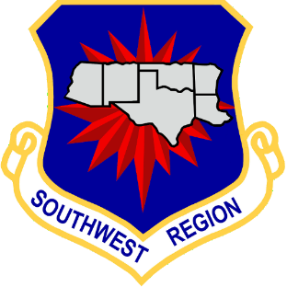
OTC and Prescription Safety
Lt. Col. Kacy Harsha
SWR DDRA

Slide 2
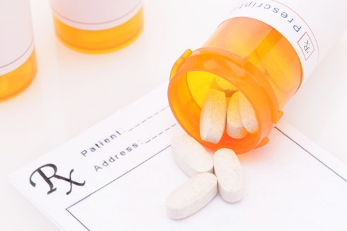
Introduction and Overview
Medications, including prescription and over the counter (OTC) are extremely beneficial and can also be very dangerous.
* OTC warnings and precautions
* Prescription warnings and precautions
* Signs of Overdose
* What to do?
* Addiction Assistance

Slide 3
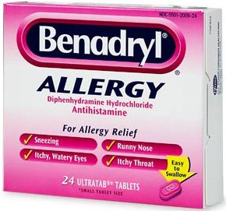
Over the Counter Medications
Medications that can be obtained without a prescription are called over-the-counter medications. These medications have instructions included that are CRITICAL to follow.
You might have heard about the recent Tic Tok Benadryl challenge. While Benadryl is very helpful for allergy suffers, when used inappropriately, may cause death. A 15-year old in Oklahoma passed recently (Aug. 2020) because of this challenge. ALL over-the counter medications MUST be used as written on the instructions. Even seemingly “harmless” medication can cause serious health issues and possibly death.
Medications containing dextromethorphan (or DXM) cannot be sold to children under 18 due to the potential abuse. The FDA reports multiple deaths due to misuse of medications containing DXM, mainly cough medications. Over half of the OTC’s on the market have DXM (medicinenet.com)

Slide 4
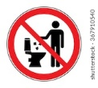
Prescriptions warnings and precautions.
Always use prescriptions as directed.
Read the insert when starting a new medication or discuss the medication with your pharmacist.
NEVER share a prescription with anyone, even family as it is unsafe and illegal.
Even though a prescription is legal to take, it may be illegal to participate in CAP activities or use corporate assets such as vehicles and airplanes while under the influence of many prescription drugs.
Unused prescriptions need to be disposed of properly in collection containers. Do NOT flush them down the toilet or put in trash cans.

Slide 5
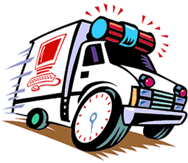
Signs of Overdose
Shallow breathing
Weak pulse, fast pulse, or irregular pulse
Clammy skin
Psychotic features
Agitation
Delirium
Loss of consciousness or passing out
Profound drowsiness
Unsteady gait
Vomiting
Tachycardia
Markedly constricted pupils
Seizures
Skin color changes: blue or ruddy
Opioid overdose is one of the most common and deadly, use of Naloxone if available will save their life and its use cannot cause any negative effect if it is NOT the cause.

Slide 6
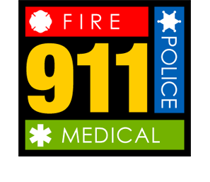
What to DO??
Poison control 1-800-222-1222
Poison.org
Never hesitate to call poison control for advice, information, or instructions.
Never hesitate to call 911 if you are not sure about what is taking place in a situation.
Render first aid for symptoms while waiting for assistance from more experienced medical professionals

Slide 7
Addiction Assistance
Addiction is being addicted to a particular substance, thing, or activity.
Addictions that are dangerous include but not limited to alcohol, drugs (OTC, prescription, legal, or illegal), or even food.
If you feel that you are addicted and need help, feel free to reach out to a trusted adult, chaplain, minister, safety officer, leader, teacher, or there are hotlines and websites that can help you.
1-800-662-4357 SAMHSA’s National helpline
7

Slide 8
Summary
-
Always use prescription AND over-the-counter medications as directed
Be aware of any abnormal behaviors or symptoms of overdose.
Never be afraid to call 911 or the Poison Control hotline for help
If you need help with addiction, please ask! Call the help line.

