Slide 1
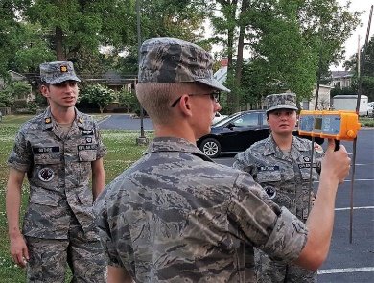
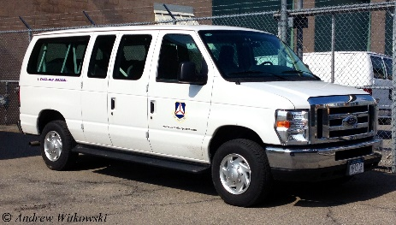
Southwest Region Safety Team
CAP Fall Weather Operations

Slide 2
SWR Fall Operations
Leaves are changing color, the weather is getting cooler, and fall is on the way.
Here are some tips to lesson the hazards of fall operations

Slide 3
Fall Operations
Prepare for changing temperatures
Daytime temperatures can be warm, but as the sun sets, the temperature may drop quickly.
Dress for the weather and be sure to have appropriate outerwear (jacket, gloves, knit hat) along so you’re prepared when the weather changes

Slide 4
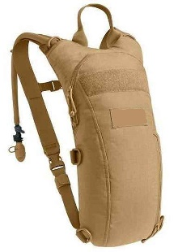
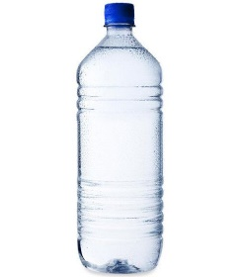
Fall Operations
Stay Hydrated
Don't rely on thirst to tell you when you need to drink water.
Proper hydration helps regulate body temperature and is essential to the function of cells, tissues and organs.
Drinking water can even give your immune system a boost and prevent you from getting sick during peak cold and flu season

Slide 5
Fall Operations
Stay Hydrated
Eat your fruits and vegetables! You can get water from the foods that you eat. Not only are fruits and vegetables good for you, but they also help you stay hydrated.
How much should you drink?
About 15.5 cups (3.7 liters) of fluids for men*
About 11.5 cups (2.7 liters) of fluids a day for women*
*From The National Academies of Sciences, Engineering, and Medicine

Slide 6
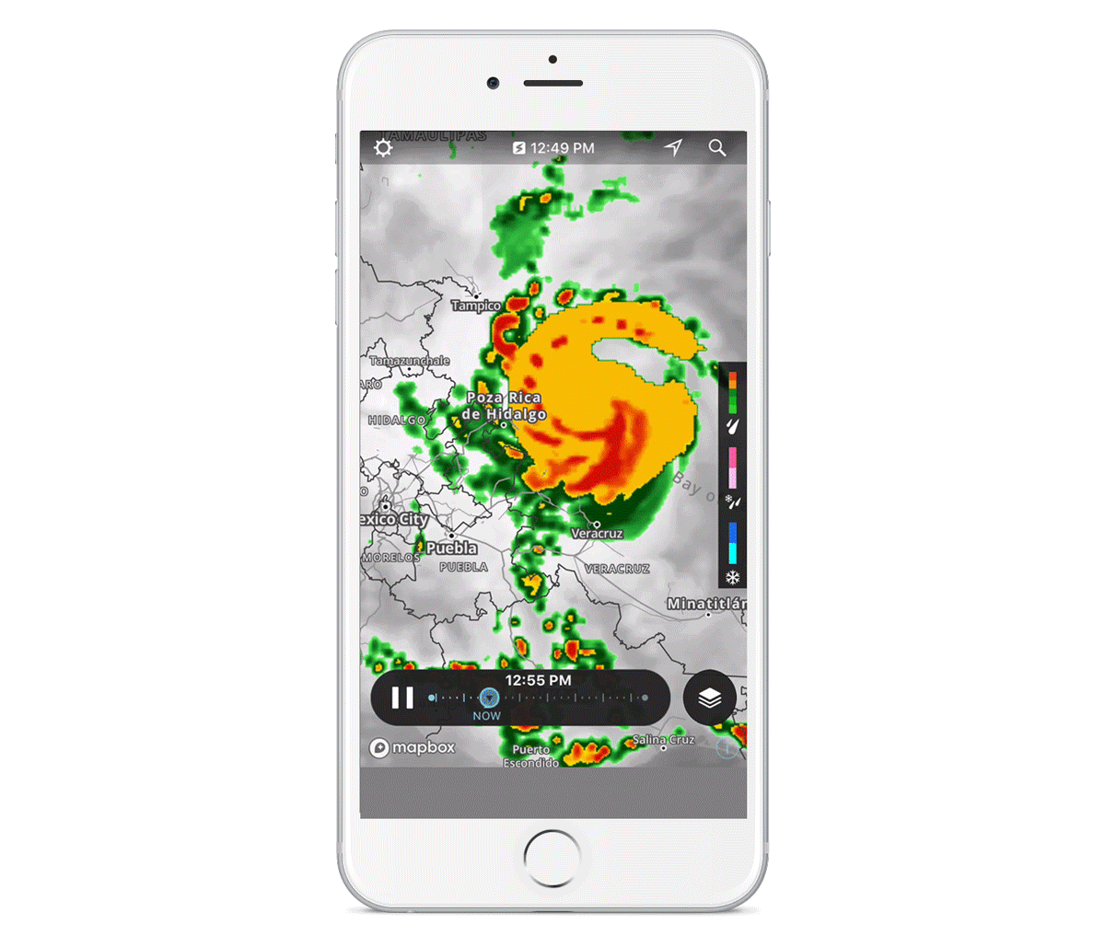
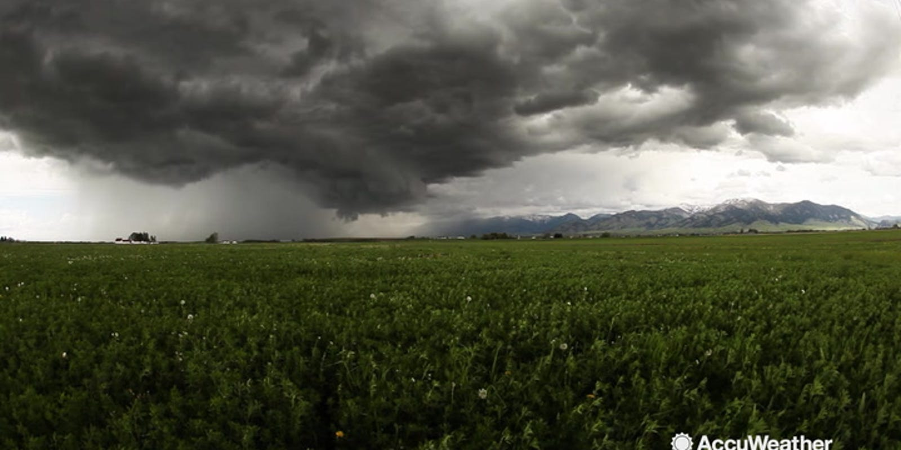
Fall Operations
Key an eye on the weather
Fall weather can be unpredictable.
Have a weather app on your phone or monitor tv/radio weather
Check forecasts in advance of any planned activity
Have an activity backup date available

Slide 7
Fall Operations
COVID
The guidance for health safety can change quickly
As Wings move to restart more in-person activities:
Use Personal Protective Equipment (masks, gloves, face shields)
Follow Social Distancing Guidelines
Check the CAP COVID-19 Information Center webpage for the latest information
https://www.gocivilairpatrol.com/covid-19-information-cena

Slide 8
Fall Driving Safety
Darkness arrives early
When driving -
Aim your headlights correctly, and make sure they're clean
Dim your dashboard lights
Look away from oncoming lights
If you wear glasses, make sure they're anti-reflective
Clean the windshield to eliminate streaks
Slow down to compensate for limited visibility and reduced stopping time

Slide 9
Fall Driving Safety
Have an annual vision exam
Reduce speed
Take a driving course; even experienced drivers can benefit from a refresher course, and some of the rules have probably changed
Minimize distractions, like talking with passengers or listening to the radio
Check with your doctor about side effects of prescription drugs
Limit driving to daytime hours if necessary

Slide 10
Fall Flying Safety
Check your currency – when was the last time you flew at night?
Fly with an Instructor or Check Pilot to regain currency or improve proficiency
Monitor weather forecasts for changing conditions
Know your airplane limitations and your personal minimums
Brush up on airplane emergency procedures

Slide 11
Southwest Region Safety Team
Thank you for taking time to review this presentation.
Please let the SWR Safety Team know of any information that can increase our knowledge of this topic or feel free to suggest a topic that will help us prevent mishaps

